Slide 1




INCOME DISCLOSURE NOTICE!
EVERYONE’S RESULTS WILL VARY AS WE ARE ALL UNIQUE AND HAVE DIFFERENT WAYS RUNNING OUR BUSINESSES. OUR SUCCESS AND INCOME TAKES HARD WORK AND DEDICATION TO ATTAIN OUR GOALS AND TARGET RESULTS. SOME WILL MAKE ENOUGH MONEY, SOME WILL MAKE MORE AND SOME PEOPLE WILL MAKE NO MONEY AT ALL. THE EARNINGS OF ANY IJASCODE HANDSOFF MS AFFILIATES WILL BE 100% DEPENDENT UPON THEIR SKILLS, EFFORT, DEDICATION, LEADERSHIP CAPABILITIES AND MARKET CONDITIONS. IJASCODE HANDSOFF MS DOES NOT GUARANTEE ANY LEVEL OF INCOME OR YOUR SUCCESS. TO SEE OUR FULL INCOME DISCLOSURE, PLEASE VISIT OUR WEBSITE AT
WWW.IJASCODE.COM
Notes:
To use this title animation slide with a new image simply 1) move the top semi-transparent shape to the side, 2) delete placeholder image,
3) click on the picture icon to add a new picture, 4) Move semi-transparent shape back to original position, 5) Update text on slide.

Slide 2
PRODUCTS & POINTS
KNOW YOUR SERVICES!
FOLLOW THE SYSTEM!
Notes:
To use this title animation slide with a new image simply 1) move the top semi-transparent shape to the side, 2) delete placeholder image,
3) click on the picture icon to add a new picture, 4) Move semi-transparent shape back to original position, 5) Update text on slide.

Slide 3

PROXIMINER ROUND MARKETING DEVICE
BASIC PACK
1 YEAR
VIP PACK
3 YEARS
GOLD PACK
5 YEARS
FORLIFE PACK
FOREVER
$199⁹⁹
$499⁹⁹
$799⁹⁹
$1,280⁹⁹
$1,299⁹⁹
  1 BUSINESS ACCOUNT
  1 PROXIMINER DEVICE
  1 YEAR MARKETING
  AUTO-RESPONDER
  (ONCE) SETUP FEE $35
  + SHIPPING
  + TAX
  $29.99 / MONTHLY
  250 IJC TOKENS / PTS
  1 BUSINESS ACCOUNT
  2 PROXIMINER DEVICES
  3 YEARS MARKETING
  AUTO-RESPONDER
  (ONCE) SETUP FEE $35
  + SHIPPING
  + TAX
  $29.99 / MONTHLY
  300 IJC TOKENS / PTS
  1 BUSINESS ACCOUNT
  3 PROXIMINER DEVICES
  5 YEARS MARKETING
  AUTO-RESPONDER
  (ONCE) SETUP FEE $35
  + SHIPPING
  + TAX
  $29.99 / MONTHLY
  400 IJC TOKENS / PTS
  2 BUSINESS ACCOUNTS
  4 PROXIMINER DEVICES
  FOREVER MARKETING
  AUTO-RESPONDER
  (ONCE) SETUP FEE $35
  + SHIPPING
  + TAX
  $29.99 / MONTHLY
  500 IJC TOKENS / PTS
FREE IJASAPP
FREE IJASAPP
FREE IJASAPP
FREE IJASAPP

Slide 4
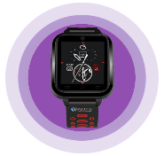
PROXIMINER WEARABLE MARKETING DEVICE
SOLO PACK
1 YEAR
LOVERS PACK
3 YEARS
TRIO PACK
5 YEARS
FIESTA PACK
FOREVER
$329⁹⁹
$629⁹⁹
$1,529⁹⁹
$1,280⁹⁹
$1,829⁹⁹
  1 BUSINESS ACCOUNT
  1 WEARABLE DEVICE
  1 YEAR MARKETING
  AUTO-RESPONDER
  (ONCE) SETUP FEE $35
  + SHIPPING
  + TAX
  $29.99 / MONTHLY
  250 IJC TOKENS / PTS
  1 BUSINESS ACCOUNT
  2 WEARABLE DEVICES
  2 YEARS MARKETING
  AUTO-RESPONDER
  (ONCE) SETUP FEE $35
  + SHIPPING
  + TAX
  $29.99 / MONTHLY
  400 IJC TOKENS / PTS
  1 BUSINESS ACCOUNT
  3 WEARABLE DEVICES
  3 YEARS MARKETING
  AUTO-RESPONDER
  (ONCE) SETUP FEE $35
  + SHIPPING
  + TAX
  $29.99 / MONTHLY
  700 IJC TOKENS / PTS
  2 BUSINESS ACCOUNTS
  4 WEARABLE DEVICES
  FOREVER MARKETING
  AUTO-RESPONDER
  (ONCE) SETUP FEE $35
  + SHIPPING
  + TAX
  $29.99 / MONTHLY
  1,000 IJC TOKENS / PTS
FREE IJASAPP
FREE IJASAPP
FREE IJASAPP
FREE IJASAPP

Slide 5


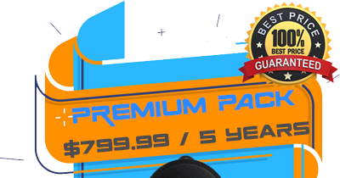

PACKAGES, Points and tokens
PROXIMINER ROUND MARKETING DEVICE
250PTS | 300 PTS | 400 PTS | 500 PTS
250 TOKENS | 300 TOKENS | 400 TOKENS | 500 TOKENS
One Time Lock-In Points | One Time Lock-In Points | One Time Lock-In Points | One Time Lock-In Points

Slide 6
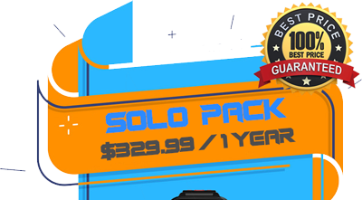
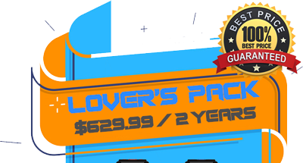
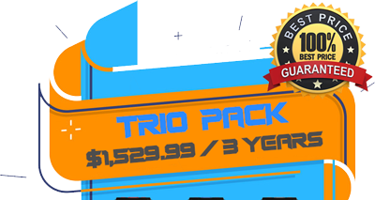
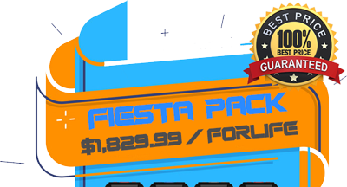
PACKAGES, Points and tokens
PROXIMINER WEARABLE MARKETING DEVICE
250PTS | 400 PTS | 700 PTS | 1,000 PTS
250 TOKENS | 400 TOKENS | 700 TOKENS | 1,000 TOKENS
One Time Lock-In Points | One Time Lock-In Points | One Time Lock-In Points | One Time Lock-In Points

Slide 7
PACKAGES, Points and tokens
PROXIMINER ROUND MARKETING DEVICE
COMMERCIAL PACKAGES
COMMERCIAL PACK 1 | COMMERCIAL PACK 2 | COMMERCIAL PACK 3 | COMMERCIAL PACK 4
$4,999.99 | $14,999.99 | $49,999.99 | $99,999.99
4,500 PTS | 15,000 PTS | 50,000 PTS | 100,000 PTS
4,500 TOKENS | 15,000 TOKENS | 50,000 TOKENS | 100,000 TOKENS
One Time Lock-In Points | One Time Lock-In Points | One Time Lock-In Points | One Time Lock-In Points

Slide 8
BASIC COMPENSATION
PLAN
FOLLOW THE SYSTEM!
Notes:
To use this title animation slide with a new image simply 1) move the top semi-transparent shape to the side, 2) delete placeholder image,
3) click on the picture icon to add a new picture, 4) Move semi-transparent shape back to original position, 5) Update text on slide.

Slide 9

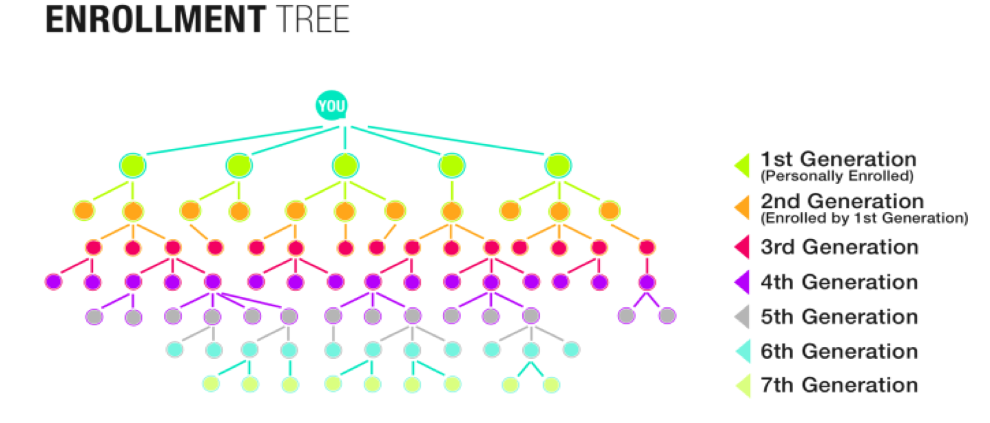

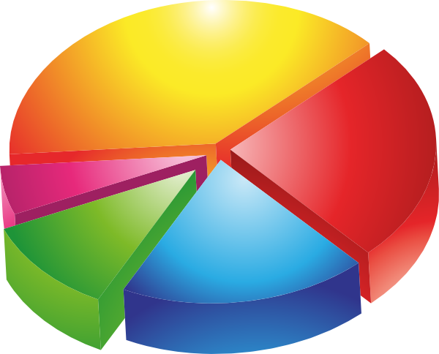
8 WAYS TO EARN COMMISSIONS AND INCENTIVES
01
- DIRECT REFERRALS - EARN DIRECT COMMISSIONS, UP TO 55%
02
- GENERATIONAL BONUS - HELP YOUR TEAM, EARN GENERATIONAL BONUSES!
03
- MONTHLY POOL - Up TO 3% From Entire Team Under
04
- YEARLY POOL - Up TO 7% From Entire Team Under

Slide 10



8 WAYS TO EARN COMMISSIONS AND INCENTIVES
05
- MATCHING BONUS - EARN WEEKLY MATCHING PACKAGE BONUS
06
- IJASCOIN TOKEN - RECEIVE POSITION BONUS INCLUDING OUR OWN CRYPTO CURRENCY TOKENS.
07
- MORE INCENTIVES - ENJOY LOTS OF INCENTIVES SUCH AS CAR ALLOWANCE, LUXURY JEWELRIES, VACATIONS, AND MORE.
08
25,000
CLASS A
COMPANY
SHARES
- COMPANY STOCKS - IJASCODE IS ACQUARING SEC REG A+ COMPLIANCE. IT MEANS YOU WILL OWN COMPANY CLASS A SHARES.

Slide 11


Ijascode CUSTOMER Referral PROGRAM
10%
Referral Commission From Each Person
Refer 3
Your Monthly Maintenance Fee is Waived Off
YOU
Get ROI Faster!
Make Some Extra!

Slide 12



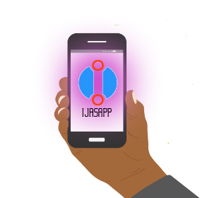

3 Simple steps to be a qualified ijascode affiliate
STEP 1 - Select Any Ijascode Package
STEP 2 - Acquire 2 Customers (500 Pts)
STEP 3 - Refer 5 Friends To Download FREE ”IjasApp Physical Web” Mobile App
YOU
For More Details, Please Read Advanced Comp Plan Section

Slide 13

3 ways to fast-start bonus in 15 days
And be a silver affiliate quickly !
STEP 1 - Select Your Own Package
STEP 2 - Acquire 2 Customers (500 Pts)
STEP 3 - Refer 5 Friends To Download FREE
”IjasApp Physical Web” Mobile App
$85
STEP 1 - Select Your Own Package
STEP 2 - Acquire 2 Customers (600 Pts)
STEP 3 - Refer 5 Friends To Download FREE
”IjasApp Physical Web” Mobile App
$250
YOU
STEP 1 - Select Your Own Package
STEP 2 - Acquire 2 Customers (1,000 Pts)
STEP 3 - Refer 5 Friends To Download FREE
”IjasApp Physical Web” Mobile App
$500
For More Details, Please Read Advanced Comp Plan Section

Slide 14



Ijascode affiliate program
500 Pts (PSV)
Personal Sales Volume
2 Direct Active Referrals
5 IjasApp Referral Downloads
1,000 Pts (PSV)
Personal Sales Volume
4 Direct Active Referrals
15 IjasApp Referral Downloads
3,000 Pts (PSV)
Personal Sales Volume
5 Direct Active Referrals
25 IjasApp Referral Download
15%
(Direct) 1st Generation
25%
(Direct) 1st Generation
5% 2nd Gen
35%
(Direct) 1st Generation
5% 2nd Gen and 3% 3rd Gen
For More Details, Please Read Advanced Comp Plan Section

Slide 15
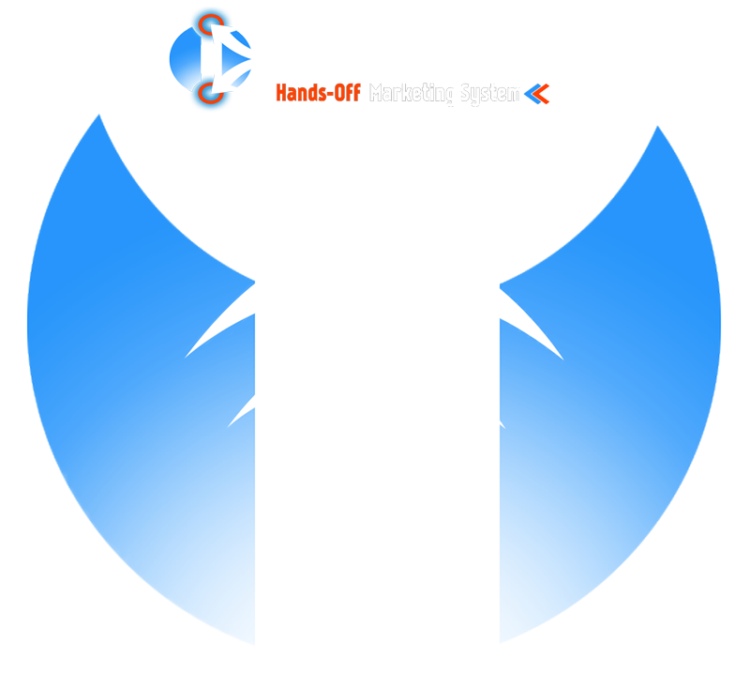


Executive Diamond affiliate
Requirements: 3,000 PSV (Personal Sales Volume) + 18,000 TSV (Team
Sales Volume) + 6 Direct Active Customers + 200 Total Team IjasApp Downloads + 4 Platinum + 4 Gold + 4 Silver
45% Direct 1ST GEN, 10% 2ND GEN, 5% 3rd GEN , 3% 4th GEN,
3% 5th GEN
New Weekly Matching Package Bonus - 5% 2nd GEN, 3% 3rd GEN, 3% 4th GEN , 3% 5th GEN
(5TH GENERATION MAX - Weekly Cycle)
Monthly Team Bonus Pool 5%
(5TH GENERATION MAX - From Active Monthly Subscriptions Only)
Yearly Team Bonus Pool 10%
(5TH GENERATION MAX - From Active Monthly Subscriptions Only)
Receive Cryptocurrency Worth of IJC 250,000
1,000 Class A Company Stocks
1,000
CLASS A
COMPANY
STOCKS
For More Details, Please Read Advanced Comp Plan Section

Slide 16

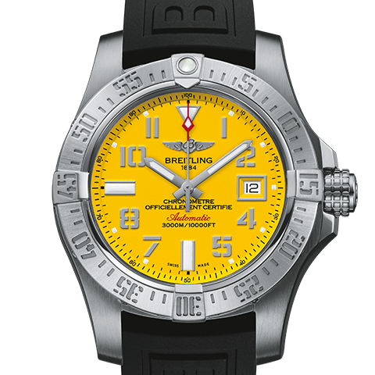


Blue Diamond affiliate
Requirements: 5,000 PSV (Personal Sales Volume) + 60,000 TSV (Team
Sales Volume) + 6 Direct Active Customers + 500 Total Team IjasApp Downloads + 2 Executive Diamond, 6 Platinum, 4 Gold and 4 Silver
50% Direct 1ST GEN, 10% 2ND GEN, 8% 3rd GEN, 5% 4th GEN, 5% 5th GEN, 3% 6th GEN AND 3% 7TH GEN
New Weekly Matching Package Bonus - 10% 2nd GEN, 8% 3rd GEN, 5% 4th GEN, 3% 5th GEN, 3% 6th GEN AND 3% 7TH GEN
(7TH GENERATION MAX - Weekly Cycle)
Monthly Team Bonus Pool 10%
(7TH GENERATION MAX - From Active Monthly Subscriptions Only)
Yearly Team Bonus Pool 15%
(7TH GENERATION MAX - From Active Monthly Subscriptions Only)
Receive Cryptocurrency Worth of IJC 500,000
10,000 Class A Company Stocks
BREITLING
CHRONOMAT 44
10,000
CLASS A
COMPANY
SHARES
For More Details, Please Read Advanced Comp Plan Section

Slide 17

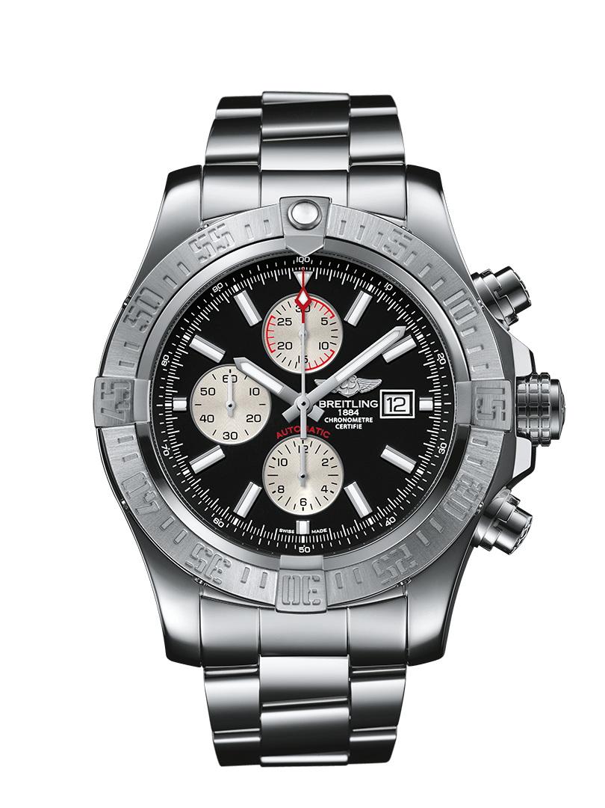


Grand Diamond affiliate
Requirements: 5,000 PSV (Personal Sales Volume) + 200,000 TSV (Team Sales Volume) + 6 Direct Active Customers + 1,000 Total Team IjasApp Downloads
+ 2 Blue Diamond + 3 Executive Diamond + 6 Platinum + 8 Gold + 4 Silver
55% Direct 1ST GEN, 10% 2ND GEN, 10% 3rd GEN, 8% 4th GEN, 8% 5th GEN, 5% 6th Gen, 5% 7th Gen, 3% 8th Gen to 10th GEN
New Weekly Matching Package Bonus - 10% 2ND GEN, 10% 3rd GEN, 10% 4th GEN, 8% 5th GEN, 5% 6th Gen, 5% 7th Gen, 3% 8th Gen to 10th GEN
(10TH GENERATION MAX - Weekly Cycle)
Monthly Team Bonus Pool 20%
(10TH GENERATION MAX – From Active Monthly Subscriptions Only)
Yearly Team Bonus Pool 30%
(10TH GENERATION MAX - From Active Monthly Subscriptions Only)
Receive Cryptocurrency worth of IJC 1,000,000
BMW CAR Allowance, any of your choice MUST be BLUE! - $800
25,000 Class A Company Stocks
25,000
CLASS A
COMPANY
SHARES
For More Details, Please Read Advanced Comp Plan Section

Slide 18






Accumulate Points, be there faster
3,000 Pts
3,000 Pts
500 Pts
500 Pts
3,000 PSV
3,000 Pts
3,000 Pts
500 Pts
500 Pts
500 Pts
500 Pts
3,000 Pts
3,000 Pts
18,000 TSV
For More Details, Please Read Advanced Comp Plan Section

Slide 19




Monthly Generational matching package bonus
Based on Position
(Start With Executive Diamond)
(Max of 10th Generation)
1st Gen
YOU
1st Gen
Package 4
Package 3
MATCH
PACKAGE
Package 2
MATCH
PACKAGE
Package 1
1st Gen
Package 4
Package 3
Package 1
Package 2
MATCH
PACKAGE
MATCH
PACKAGE
Package 1
Package 2
For More Details, Please Read Advanced Comp Plan Section

Slide 20
ADVANCED
COMPENSATION
PLAN
FOLLOW THE SYSTEM!
Notes:
To use this title animation slide with a new image simply 1) move the top semi-transparent shape to the side, 2) delete placeholder image,
3) click on the picture icon to add a new picture, 4) Move semi-transparent shape back to original position, 5) Update text on slide.

Slide 21
CUSTOMER AND AFFILIATE PROGRAM
AS A CUSTOMER:
Any customer who has an active package with the monthly subscription, can refer unlimited number of clients to Ijascode company and will be entitled to receive the following referral commissions or incentives.
Get 10% package commission from any of the purchased package that the referred client acquire from the company.
Any customers who referred 3 active referrals to the company, the monthly subscription fee will be waived off for as long as these 3 active referrals are paying their monthly subscription fees.
AS A QUALIFIED AFFILIATE:
Company has very unique and strict rules when it comes to affiliate program. Anyone who wants to participate in the program MUST agree to all the terms and policies of the company and undergo to the series of verification process.
Any Existing customer who has an active package with the monthly subscription, can participate into Ijascode Affiliate program at anytime by completing the following simple qualifications:
1) Refer 2 clients with a purchase of at least a BASIC package for each person or 500 Product Points.
2) Refer by downloading FREE “IjasApp Physical Web” Mobile app to at least 5 people
For NEW affiliates, they must complete the following qualifications as required by the company and to follow the standard Direct Selling Practices:
1) Acquire at least BASIC Package to promote the company, to be equipped and learn more about the products and services.
2) Refer 2 clients with a purchase of at least a BASIC package for each person or 500 Product Points.
3) Refer by downloading FREE “IjasApp Physical Web” Mobile app to at least 5 people

Slide 22
PRODUCTS, SERVICES AND POINTS SYSTEM
PRODUCTS AND SERVICES:
Ijascode has 2 active products as of the moment and as we progress, company may change or enhance the product features and services. It means that the prices could relatively be affected and changed as well.
Below are the products and corresponding points:
IJASCODE HANDSOFF PROXIMINER ROUND DEVICE:
BASIC PACKAGE – 250 PTS
VIP PACKAGE – 300 PTS
SPECIAL BUSINESS GOLD PACKAGE – 300 PTS
FORLIFE PACKAGE – 500 PTS
IJASCODE HANDSOFF PROXIMINER WEARABLE DEVICE:
SOLO PACKAGE – 250 PTS
LOVERS PACKAGE – 400 PTS
TRIO BUSINESS GOLD PACKAGE – 700 PTS
FIESTA PACKAGE – 1,000 PTS
HOW IS THE POINT SYSTEM WORKS:
The company assigned corresponding POINTS to each Ijascode package, and every package that you personally acquired will be counted to the person who sponsored you into the business.
Example of Personal Points: If John sponsored Person A with a Basic Package (250 Pts) and Person B with a Solo Package (250 Pts), John will earn 500 Personal Sales Volume from those 2 referrals that he personally introduced into the business.
Example of Team Points: If those 2 referrals that John personally sponsored, Person A and Person B also sponsored Person C with a Fiesta Pack (1,000 Pts) and Person D with a Forlife Package (500 Pts), now John will earn 1,500 Team Points from those 2 NEW referrals that his team Person A and Person B got introduced into the business.
Also John understand the power of Mobile App so he quickly shared the “IjasApp”to his 5 family members to download.
In Summary: John has share the IjasApp to 5 family members, he earned 500 Personal Sales Volume (PSV) and 1,500 Team Sales Volume (TSV).
John is now a qualified Ijascode Affiliate with a Position of Silver Affiliate.

Slide 23
IJASCODE POSITIONS AND CYCLES
IJASCODE AFFILIATE POSITIONS:
Every affiliate MUST meet all the requirements before the system promote any individual to a new position.
NOTE! Every position achieved is PERMANENT and NO demotion! ONCE you achieved your Position its yours unless you give it up with a written resignation letter or you got terminated due to the Policy violation.
How Can I Lose My Position?
Personally quit with a personal notice or letter with the proper signature in it.
Terminated by the company board due to the violation of company policy.
2 Months of Inactive-Account status including the monthly subscription fee,
Zero personal production and
Zero support to the team you sponsored.
THERE IS A 30 DAY RANK-UP CYCLE THAT APPLIES TO ALL POSITIONS STARTING FROM EXECUTIVE DIAMOND AFFILIATE:
Every month the company will do a cycle that eliminates 50% of the total Team Sales Volume. Positions such as Silver, Gold and Platinum Director are not affected by the cycle, however this could affect the upper sponsors who are running for the higher ranks.
If John’s current position is Executive Diamond Affiliate and he is running to go up to the level of Blue Diamond Affiliate that requires 60,000 Team Sales Volume, he MUST complete the said 60,000 TSV within 30 days to rank up.
Scenario 1: If John has 60,000 TSV by the end of January, he will be promoted to BLUE Diamond Affiliate and then the company will automatically subtract 50% off of 60,000 TSV. On February 1st, John’s Team Sales Volume is equal to 30,000 TSV.
Scenario 2: If John has 50,000 TSV by the end of January, he will not be promoted to Blue Diamond Affiliate and then the company will subtract 50% off of 50,000 TSV. On February 1st, John’s Team Sales Volume is equal to 25,000 TSV.

Slide 24
COMMISSIONS, BONUSES AND ADDITIONAL INCENTIVES
IJASCODE PAYOUTS:
Any Ijascode Affiliates or Customers who earned commissions can sign up for the Ijascode Mastercard Prepaid card to receive payouts bi-weekly.
All commissions, bonuses and monthly incentives are being released either on the 15th or 30th of each month.
Each commission or bonus must appear to the system 1 week before the Payout Cycle cut off date.
Example 1: If John referred 2 new customers to Ijascode on January 5, the commission will be released on January 15 Payout Cycle.
Example 2: If John referred 2 new customers to Ijascode on January 10, the commission will be released on January 15 Payout Cycle.
Example 3: If John referred 2 new customers to Ijascode on January 13, the commission will be released on January 30 Payout Cycle.
Example 4: If John referred 2 new customers to Ijascode on January 28, the commission will be released on February 15 Payout Cycle.
15 Days Fast-Start Bonus
Applicable to existing customer or new affiliate who finished the requirements to be a qualified Silver Affiliate in 15 days. The counting of days will start as soon as the person sign up and the system will start tracking the progress of each account.
Generational Commission
This commission starts as soon as you become Qualified Silver Affiliate. This commission is generated and release every Payout Cycle. See the Payout Cycle Page. Below is the Generational Bonuses per Affiliate Position:
Silver Affiliate – 15% Direct 1st Generation
Gold Affiliate – 25% Direct 1st Generation and 5% 2nd Generation
Platinum Director – 35% 1st Gen, 5% 2nd Gen and 3% 3rd Gen
Executive Diamond – 45% Direct 1ST GEN, 10% 2ND GEN, 5% 3rd GEN, 3% 4th GEN, 3% 5th GEN
Blue Diamond – 50% Direct 1ST GEN, 10% 2ND GEN, 8% 3rd GEN, 5% 4th GEN, 5% 5th GEN, 3% 6th GEN AND 3% 7TH GEN
Grand Diamond – 55% Direct 1ST GEN, 10% 2ND GEN, 10% 3rd GEN, 8% 4th GEN, 8% 5th GEN, 5% 6th Gen, 5% 7th Gen, 3% 8th Gen to 10th GEN

Slide 25
COMMISSIONS, BONUSES AND ADDITIONAL INCENTIVES
WEEKLY MATCHING PACKAGE BONUS:
This powerful extra bonus will start when the affiliate hit Gold Affiliate. Every week the system will look and find every pair of matching package in every single line under your team. So it means that every week you can earn matching package bonus which will be released on the standard 15th and 30th Payout Cycle. See the Payout Cycle Page.
Each pair is calculated on the pairing package price starting from the 2nd Generation down to the maximum generation assigned to each Position.
Gold Affiliate - 5% 2nd Gen
Platinum Affiliate – 5% 2nd Gen and 3% 3rd Gen
Executive Diamond - 5% 2nd GEN, 3% 3rd GEN, 3% 4th GEN, 3% 5th GEN
Blue Diamond - 10% 2nd GEN, 8% 3rd GEN, 5% 4th GEN, 3% 5th GEN, 3% 6th GEN AND 3% 7th GEN
Grand Diamond - 10% 2ND GEN, 10% 3rd GEN, 10% 4th GEN, 8% 5th GEN, 5% 6th Gen, 5% 7th Gen, 3% 8th Gen to 10th GEN
Example 1: John is Executive Diamond, and he has Sara as his 1st Generation business partner. Sara sponsored Linda with Basic Package ($199.99) and Greg with also Basic Package ($199.99). John as the Executive Diamond in that line will earn a Matching Package Bonus of 5% of the matching package price of $199.99, which is in this case $9.99
MONTHLY TEAM BONUS POOL:
This monthly bonus pool starts at the position of Executive Diamond Level. Below is the percentage that each position could potentially earn. This bonus is calculated based on the entire team limited to the maximum allowed generation. All active subscribers who pays the monthly maintenance fee (currently $29.99 or the latest maintenance fee).
Example 1: If John is Executive Diamond, he is entitled to receive monthly bonus pool of 2% from his downlines 3rd generation deep. If the active subscriber is 100 customers who pays $29.99 each month, 100 x $29.99 = $2,999, then John will get 2% of $2,999 which is $59.98.
Executive Diamond Affiliate – 5% From Active Subscriptions Per Month (5TH GENERATION MAX)
Blue Diamond Affiliate – 10% From Active Subscriptions Per Month (7th GENERATION MAX)
Grand Diamond Affiliate – 20% From Active Subscriptions Per Month (10th GENERATION MAX)

Slide 26
COMMISSIONS, BONUSES AND ADDITIONAL INCENTIVES
YEARLY TEAM BONUS POOL:
This yearly bonus pool starts at the position of Executive Diamond Level. Below is the percentage that each position could potentially earn. This bonus is calculated based on the entire team limited to the maximum allowed generation.
NOTE! All active subscribers who pays the monthly maintenance fee (currently $29.99 or the latest maintenance fee) MUST active accounts with no less than 2 months in the system and MUST be active accounts during the end of the year period to be counted to this pool.
Example 1: If John is Executive Diamond, he is entitled to receive yearly bonus pool of 3% from his downlines 3rd generation deep. If the active subscribers on December 31 is 5,000 customers who pays $29.99 each month, 5,000 x $29.99 = $149,950, then John will get 3% of $149,950 which is $4,498.50.
Executive Diamond Affiliate – 10% From Active Subscriptions Per Month (5TH GENERATION MAX)
Blue Diamond Affiliate – 15% From Active Subscriptions Per Month (7th GENERATION MAX)
Grand Diamond Affiliate – 30% From Active Subscriptions Per Month (10th GENERATION MAX)
RANK IJASCOIN CRYPTO DIGITAL TOKEN BONUS:
On top of the earned Personal Team Sales Volume and Team Sales Volume which are convertible to IjasCoin Tokens, this RANK BONUS is a one-time bonus whoever hits the position of Executive Diamond, Blue Diamond and Grand Diamond.
ADDITIONAL INCENTIVES:
Executive Diamond – Receive 1,000 Class A Company Stock Options
Blue Diamond – Receive 10,000 Class A Company Stock Options and worth $5,000 Breitling Watch
Grand Diamond – Receive 25,000 Class A Company Stock Options, worth $10,000 Breitling Watch and a monthly BMW Car Allowance of $1,000
NOTE! To maintain the Car Allowance, the affiliate MUST maintain at least 10,000 Team Sales Volume every month OR 40 Active Direct Customers.

